Slide 1
Unit 3: Week 3
Grade K

Slide 2
Copyright © Savvas Learning Company LLC. All Rights Reserved.
This publication is protected by copyright, and permission should be obtained from the publisher prior to any prohibited reproduction, storage in a retrieval system, or transmission in any form or by any means, electronic, mechanical, photocopying, recording, or otherwise. For information regarding permissions, request forms, and the appropriate contacts within the Savvas Learning Company Rights Management group, please send your query to:
Savvas Learning Company LLC, 15 East Midland Avenue, Paramus, NJ 07652
or
k12learningpermissions@savvas.com
myView Literacy® is an exclusive trademark of Savvas Learning Company LLC in the U.S. and/or other countries.

Slide 3
Lesson 1

Slide 4
Page 100
Phonological Awareness
Turn to page 100 in your Student Interactive.
Notes:
Tell students that today they are going to work with syllables. Syllables are word parts. Each syllable in a word has one vowel sound. Listen to this word: seashell. Now listen as I say the word again: star (pause) fish. Can you hear the two syllables: star (pause) fish? What are the syllables? Students should say star and fish.
Have students turn to p. 100 in the Student Interactive to practice manipulating syllables in multisyllabic words. Explain that they will be figuring out the syllables in some words. Then they will take away one of the syllables and draw a picture of the new word in the box.
Say: Listen to this picture word: toothbrush. What are the syllables in the word? Students should say tooth and brush.
Help students identify the other picture words on p. 100.

Slide 5
Page 101
Phonics
Turn to page 101 in your Student Interactive.
Notes:
Hold up Alphabet Card Zz and point to the picture of the zigzag. Have students say zigzag with you. Let’s say the sound at the beginning of the word: /z/. The sound /z/ is spelled with the letter z.
Point to the letters Zz on the Alphabet Card. Tell students the word zigzag begins with the sound /z/, so it begins with the letter z. Click path -> Table of Contents -> Unit 3 Week 3 Poetry-> Lesson 1
Write the letters Z and z on the board. Have students turn to p. 101 in the Student Interactive and trace the letters on the first set of lines with their fingers. Tell students that you will say a group of words and they will listen for the initial sound /z/.
Students will trace the letter z in the air as you say each word with the sound /z/. Tell them not to trace for other words. Use the following words: zoo, zebra, zoom, hail, zip, pit.
Have students look at p. 101 in the Student Interactive. Point to the letter z and tell me the sound it spells.
Direct students to the first picture. Say the word zipper, emphasizing the initial sound: /z/ /z/ /z/ -ipper. Does this word begin with the sound /z/? Yes, so we will circle it. Now we will write the letters Zz on the lines.
Have students continue circling the pictures that begin with /z/ and writing the letters Zz on the lines below the pictures they circled.

Slide 6
High-Frequency Words
down
her
how
Notes:
Display the high-frequency words down, her and how.
Point to the word down and read it.
Have students point to the word down and read it.
Repeat for her and how.

Slide 7
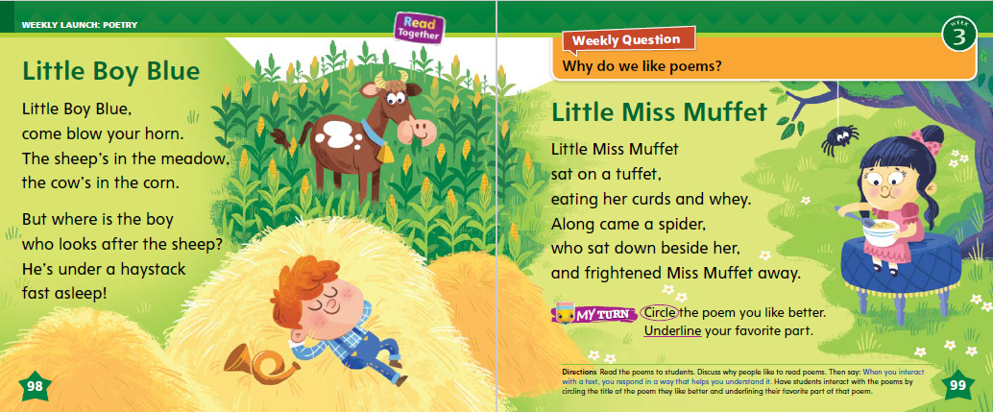
Page 98, 99
Interact with Sources
Listen and clap when you hear a rhyming word.
Circle the poem you like best.
Notes:
Remind students of the Essential Question for Unit 3: Why do we like stories? Point out the Weekly Question: Why do we like poems? Explain that students will learn about poems this week.
Ask students to tell you what they see in the illustrations on pp. 98–99 in the Student Interactive. Then talk to students about the words on the page. Tell students these are poems. They are a special kind of poem called nursery rhymes. Ask them if they recognize the poems.
Read aloud the poems and have students just listen. Then read them again, this time having students read along with you. Explain to students that they can interact with sources by illustrating, writing, or discussing their response to the text. Use the following prompts to guide discussion of the poems:
What is “Little Boy Blue” about?
Why do you think he is called Little Boy Blue?
What is “Little Miss Muffet” about?
Look at the illustration on p. 99. What do you think a tuffet is?
What does rhyme mean?
What rhymes with tuffet?
Reread the nursery rhymes, asking students to listen and clap their hands when they hear rhyming words.
Have students interact with sources by telling which of the poems they like best and why. Ask them to circle the title of the poem they like best and underline their favorite part.

Slide 8
Listening Comprehension
Find a word that rhymes with:
farm | tricks | behind | fox
Notes:
Tell students that they will listen to you read a poem. Explain that poems often have a rhythm, or beat. Poems often have lines that rhyme.
Have students listen as you read aloud the poem, “Hen and Fox.” Tell students to be active listeners by looking at you and thinking about what you are saying as you read aloud. After reading the first verse, have students tap along to the beat.
PURPOSE Have students listen actively for elements of a poem, such as rhyme and rhythm.
READ the entire text aloud without stopping for the Think Aloud callouts.
REREAD the text aloud, pausing to model Think Aloud strategies related to the genre.
Use the chart to help students identify instances of rhyming words in the poem.

Slide 9
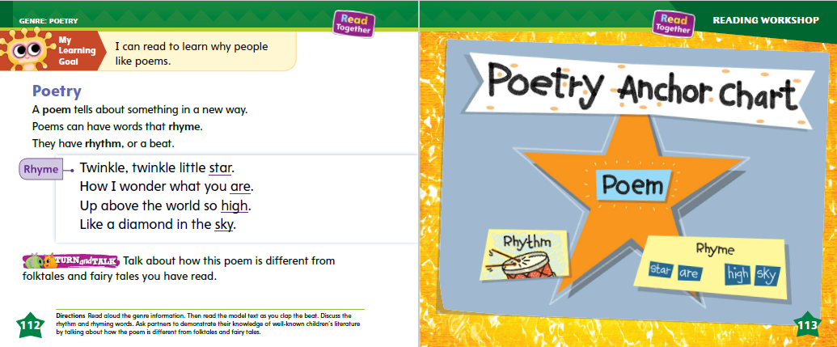
Page 112, 113
Poetry
Turn to page
112, 113
in your Student Interactive.
Notes:
Tell students that they are going to talk about poems and what a poem is. Read aloud the text on p. 112 of the Student Interactive
As students follow along in their books, running their finger under the text as you read. Tell students:
Rhyming is when words have the same middle and ending sounds, like fox and box.
Rhythm is the way we say the words in time. We can say them slow or fast. We can pause between the words. There are different types of rhythms.
Point out the features of a poem. Many poems rhyme, but they don’t have to. This poem on p. 112 does rhyme. I know that poems usually have a rhythm or a beat. Poems describe things in a new or interesting way, like saying a star is like a diamond.
Read aloud the Anchor Chart on p. 113. Editable Anchor Chart Click Path: Table of Contents -> Reading Anchor Charts -> Unit 3 Week 3: Poetry Reading Anchor Chart

Slide 10
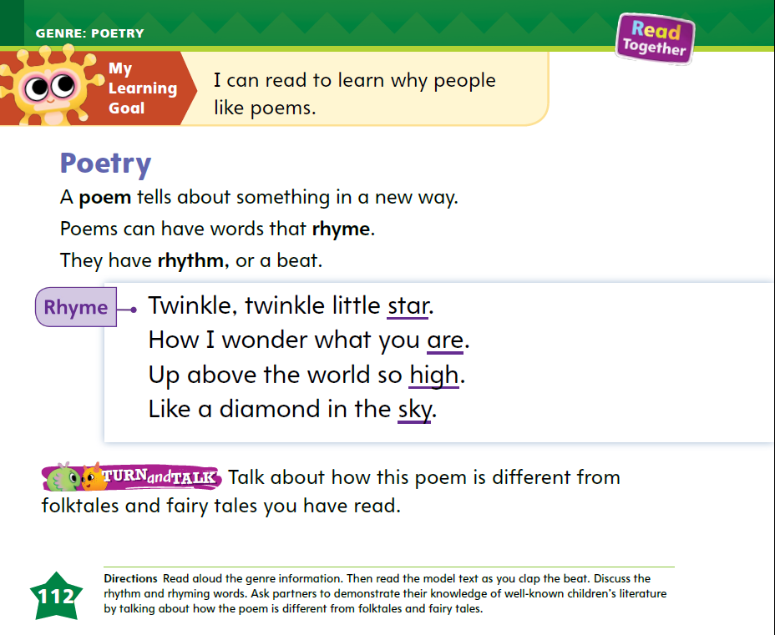
Page 112
Apply
Talk about how this poem is different from folktales and fairy tales that you have read.
Notes:
Have students use the strategies to identify the key features of a poem.
Ask students to turn and talk to a partner about the difference between poems and folktales and fairy tales. Ask them to think about some folktales or fairy tales they know. Call on several partners to share their thinking with the whole group.

Slide 11
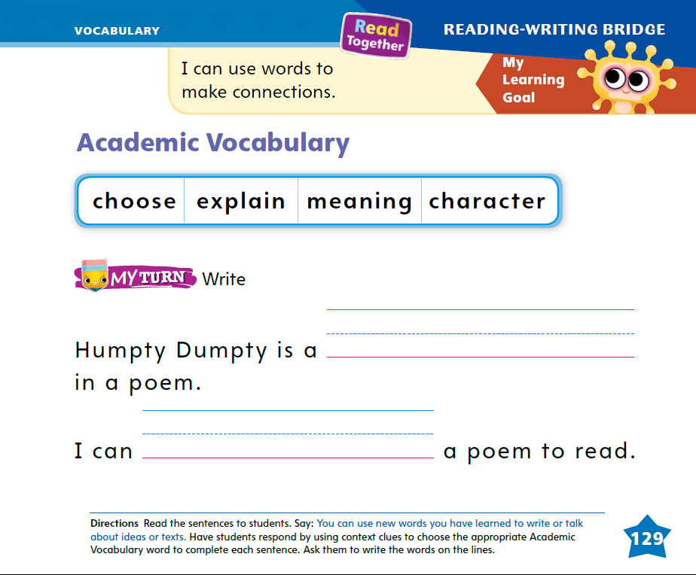
Page 129
Academic Vocabulary
Turn to page 129 in your Student Interactive
and complete the activity.
Notes:
Read aloud the Academic Vocabulary on p. 129 in the Student Interactive with students. Explain that students can respond using the newly acquired vocabulary. Discuss how using context clues can help students read new words.
Context clues are the words around a new word.
Rereading a sentence can help readers figure out the meaning of a word.
Display the sentence: I can _______ what the poem is about. Read aloud the sentence, pausing for the missing word. Model how you use the context to figure out a word. I can use the context to help me figure out the missing word. The words “what the poem is about” are a good clue. The missing word could be explain what the poem is about.
Read aloud the sentence to confirm the meaning of the newly acquired vocabulary.
Have students complete the sentences on p. 129 in the Student Interactive. Read aloud the sentences with them if they need support.

Slide 12
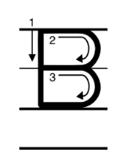
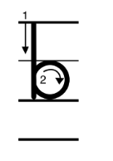
Handwriting
Notes:
Display uppercase and lowercase Bb. Ask students to identify the letters. Point out that B is a capital letter and b is lowercase.
Model how to write the uppercase letter B. Begin at the top and draw a vertical line. Go back to the top, draw a curved line to the right and back to the middle. Then make another curved line to the right and back to the bottom of the straight line. Have students practice writing the letter in the air with their fingers.
Then repeat with the lowercase letter b. Start at the top and draw a vertical line. Then add a curved line starting at the middle, and around to the bottom of the letter.
Click path: Realize -> Table of Contents -> Resource Download Center -> Handwriting Practice -> U3W1L1 Handwriting Practice

Slide 13
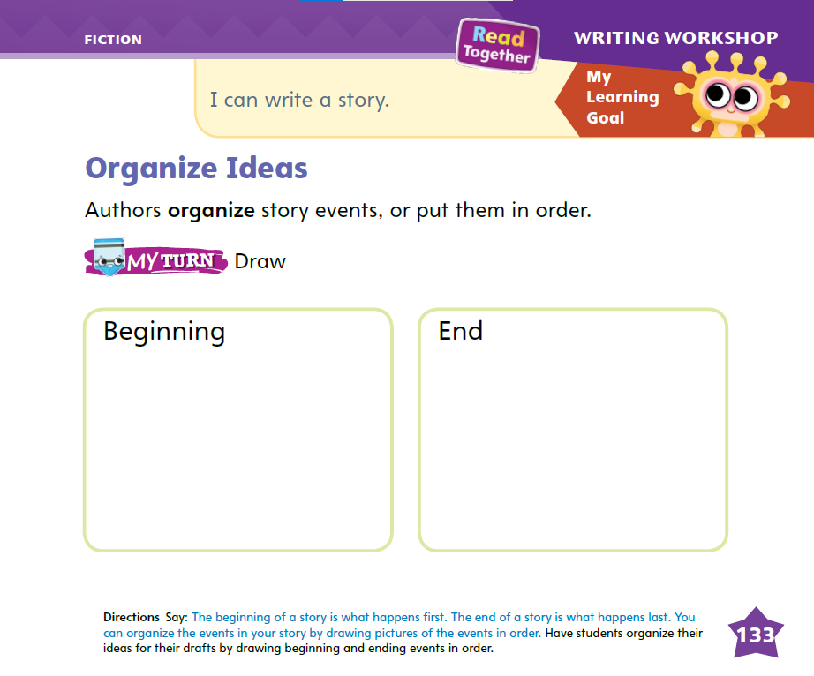
Page 133
Writing – Fiction
Turn to page
133 in your Student Interactive and complete the activity.
Notes:
Authors organize the events in their stories before writing their books. They plan the events that will happen, and they put the events in sequential order. Say: The beginning of a story is what happens first. The end of a story is what happens last. Other events happen in the middle.
Display a book from your stack. As you read, pause to point out the events and pictures in the beginning. Then continue reading and point out the events that happen in the middle. Finally, read the ending of the book and tell in your own words what happens at the end.
After reading, return to the beginning of the book and say: In the beginning of a book, we are introduced to the characters and the problem. What event happens at the beginning? Pause to let students answer. At the end of the book, the problem is solved. What event happens at the end? Call on a student to answer. Authors organize their ideas. What would happen if this book was not organized? What if the ending came first? How would the book be different? Allow students to discuss how a book would be different if the ending came first.
Tell students that they can organize the events in their story by drawing pictures of the events in order. Drawing pictures is one way to develop a draft.
Have students turn to p. 133 in the Student Interactive. Say: Now you will organize your story by drawing pictures of the events in order.

Slide 14
Independent Writing
Continue to work on your fiction books. Remember to put your ideas in order.
Share your stories with the class.
Notes:
After learning about organizing their ideas, students should continue working on their fiction books. Remind them to put their ideas in order. If needed, they can start over.
Modeled - Use stack texts to model organizing the events of a story.
Shared - Use stack texts to model organizing the events of a story.
Guided - Prompt students to consider the time and sequence of the events in their stories.
Have a few students share their stories with the class. Encourage classroom discussion about how the students feel about organizing their ideas.

Slide 15
Language and Conventions
Juan is a boy. He is a boy.
The ball hit Juan. The ball hit him.
Maria met Lucy for lunch.
Luka gave Jared a present.
Mia washed the dog.
Notes:
Remind students that objective pronouns take the place of nouns. Tell them that objective pronouns are found in the action part of the sentence. Give examples of pronouns. I remember that pronouns take the place of nouns, for example: Juan is a boy. He is a boy. The pronoun he stands for Juan.
Then review objective pronouns. Provide an example: The ball hit Juan. The ball hit him. Ask students what him stands for
Provide example sentences and call on different students to substitute an objective pronoun for the underlined word: Maria met Lucy for lunch. Luka gave Jared a present. Mia washed the dog.

Slide 16
Lesson 2

Slide 17
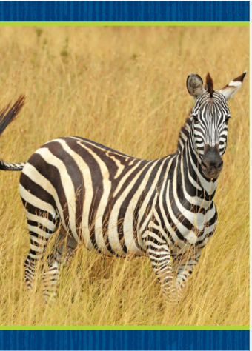
Phonics
zip
zap
Zak
jazz
zebra
Zz
Notes:
Hold up the zebra Picture Card. This is a picture of a zebra. Listen to the sounds in the word: /z/ -ebra. Listen to the sounds in the word: /z/ at the beginning of zebra. Say the sound /z/ with me. Click path -> Table of Contents -> Unit 3 Week 3 Poetry-> Lesson 1
Turn over the card and show students the spelling of the word. Point to the z and say /z/. Do you hear the sound /z/? What letter spells the sound /z/? Have students identify the letter z. Write the letters Zz on the board. Have students trace the letters Zz in the air as you lead them.
Point to the letters Zz on the board. Then display the word zip. Listen carefully to the following word: /z/ /i/ /p/. Do you hear the
sound /z/ in this word? Listen again: /z/ /i/ /p/. What letter spells the sound /z/ in zip? Have a volunteer point to the letter z in the word as students name the letter. Then display the following words, and have students decode them: zap, Zak, jazz.

Slide 18
Page 102
Apply
Turn to page 102 in your Student Interactive and complete the activity.
Notes:
Have students complete p. 102 of the Student Interactive.

Slide 19
High-Frequency Words
down
her
how
Notes:
Tell students that high-frequency words are words that they will hear and see over and over in texts.
Write and read the sight words down, her, and how. Have students
repeat the words after you.
spell each word, slapping their knees as they say each letter.

Slide 20
Preview Vocabulary
fast
soon
down
great
Share what you know about these words.
Notes:
Tell students you will start by learning some words that are in the text. Introduce the words fast, soon, down, and great.
Prompt students to share what they know about the words. Tell me something that is fast. What are you going to do soon? What ways can you go down a hill? Tell me what food you think is great.
Tell students these words will help them understand what the text is about.

Slide 21
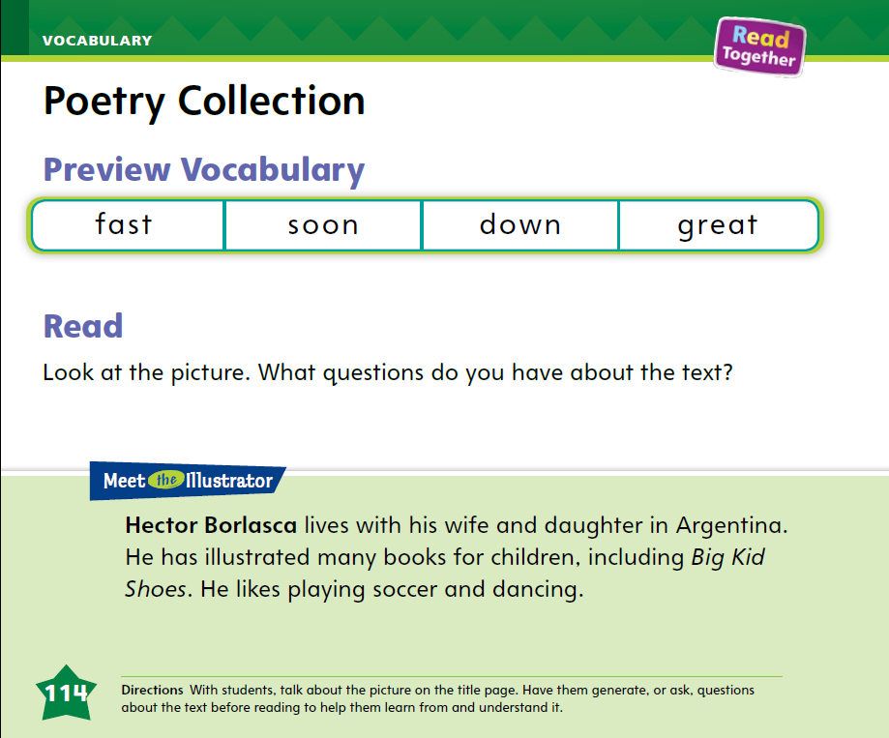
Page 114
Print Awareness
Follow along
on page 114 in the Student Interactive.
Notes:
Tell students that when they read, they should start at the top and move from left to right. When they get to the end of a line, they should move to the start of the next line and continue reading.
Model reading from top to bottom and from left to right with return sweep.
Then have students follow along as you read “Meet the Illustrator” on p. 114 in the Student Interactive.

Slide 22
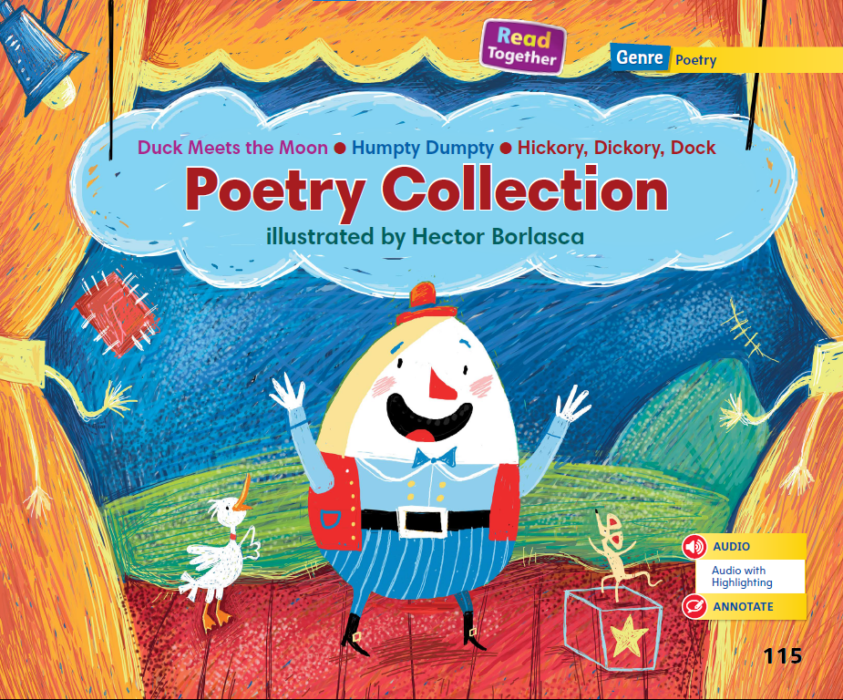
Page 115
First Read Strategies
Notes:
Have students point to the title of the selection on p. 115 of the Student Interactive and read it aloud with you. Have them point to the illustrator’s name. Read aloud the information about the illustrator.
Then guide students as they generate, or ask, questions that will help them learn from and understand the text.
Explain that if students do not understand something, they can make adjustments by rereading, using background knowledge, or checking for visual cues.
Have students monitor their comprehension as they read. If students’ understanding of the text breaks down, prompt them to make adjustments by rereading and looking at the illustrations.
First Read Strategies
READ Read or listen to the text. During the first read, students should try to understand the text.
LOOK Look at the pictures to understand the text.
ASK Ask questions about the text to deepen understanding.
TALK Talk to a partner about the text.
Students may read the text independently, in pairs, or as a whole class. Use the First Read notes to help students connect with the text and guide their understanding.

Slide 23
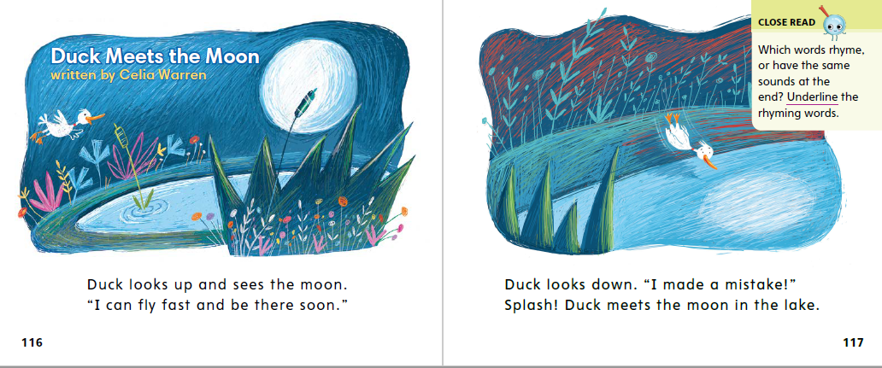
Page 116, 117
First Read – Poetry Collection
Notes:
Read together.
THINK ALOUD After reading aloud the title, say: This is a poem about a duck. What is a duck? A duck is a kind of bird. There is another meaning for the word duck. It means get out of the way.
Have students work with a partner and use both meanings of the word duck in sentences. Tell them to use the illustrations in the text to help them.

Slide 24
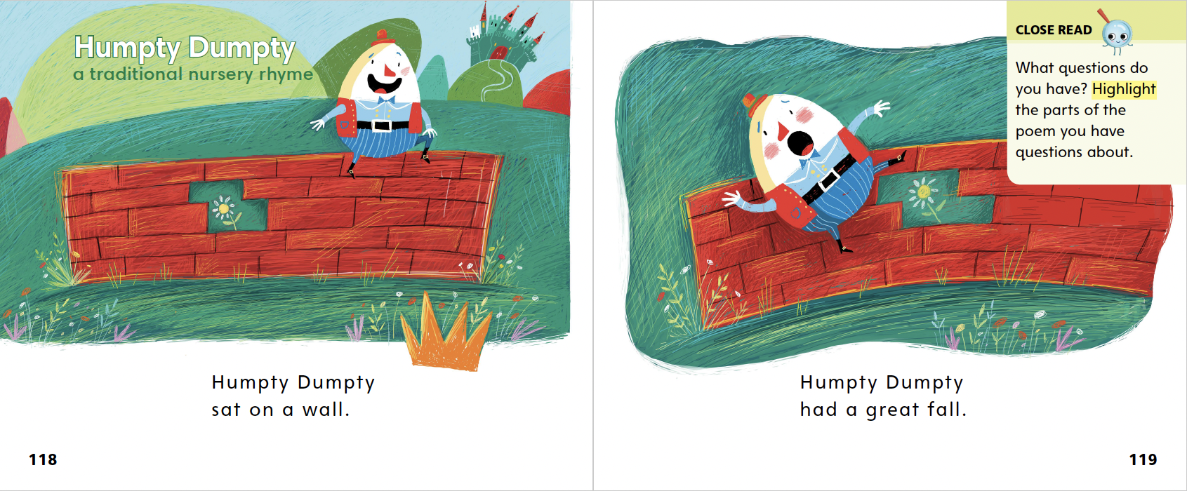
Page 118, 119
First Read – Poetry Collection
Notes:
Read together.

Slide 25
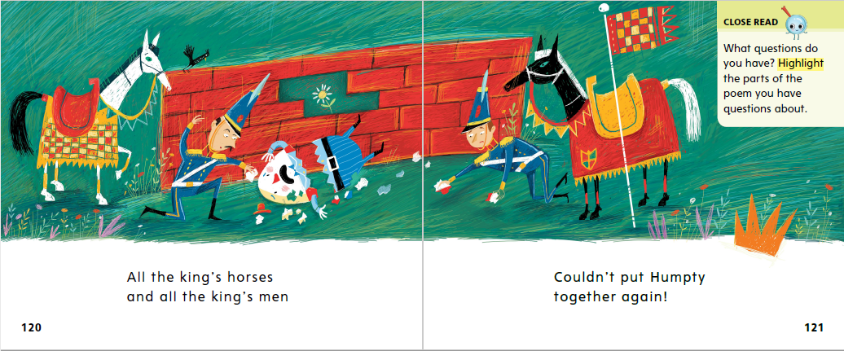
Page 120, 121
First Read – Poetry Collection
Notes:
Read together.
Think Aloud I read the word down on page 123, but I don’t know what it means. What can I do? I am going to reread the text and look at the pictures to find out. The text says that the mouse ran down the clock. I can look at the illustrations to clarify the meaning of the word. In the pictures, I see the mouse running up and then down the clock. I see that down means “to go lower.”

Slide 26
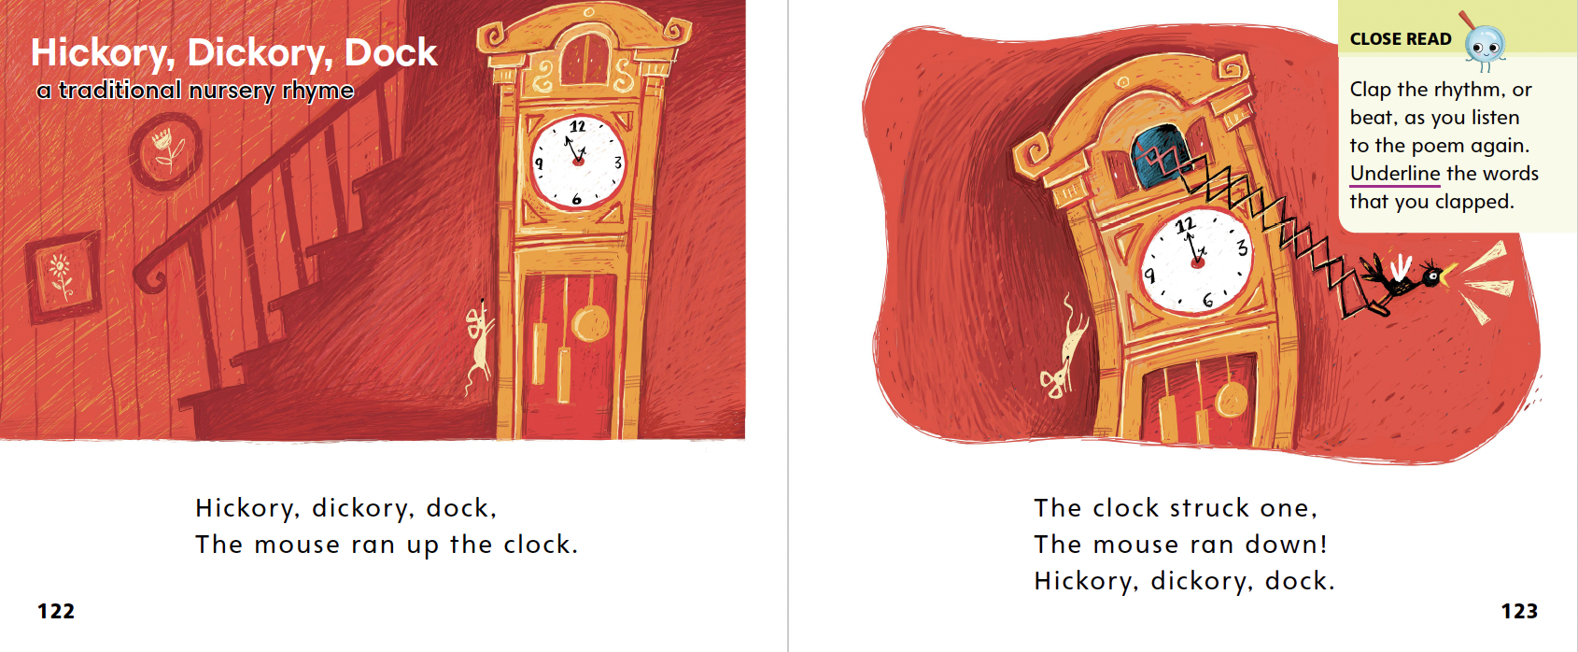
Page 122, 123
First Read – Poetry Collection
Notes:
Read together.

Slide 27
Respond and Analyze
Brainstorm What was similar about all three poems?
Discuss Which poem did you like the best?
What did you like about it?
Notes:
Use these suggestions to prompt students’ initial responses to Poetry Collection.
Brainstorm What was similar about all three poems?
Discuss Which poem did you like the best? What did you like about it?

Slide 28
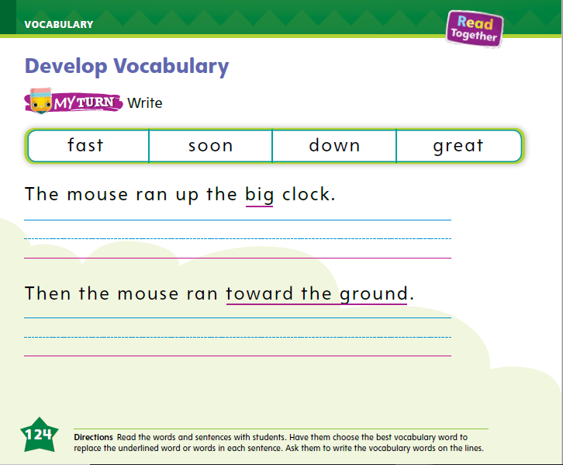
Page 124
Develop Vocabulary
Turn to page 124 in your Student Interactive and complete the activity.
Notes:
Knowing the meanings of the words fast, soon, down, and great helps you understand the poems. Some words have more than one meaning.
Read the word. Can it have more than one meaning?
Use the pictures to help you think about the meaning of the word.
Have students turn to p. 124 in the Student Interactive.
Read aloud the first sentence. I’m looking for a word that has the same meaning as big. I know that words can have more than one meaning. I can say that I had a great time, meaning I had a wonderful time. But I know that great can also mean something big.
Ask students to write the word great. Have them read the sentence aloud using the word great in place of big.
Have students use the strategies for developing vocabulary.
Have students practice developing vocabulary by completing p. 124 in the Student Interactive.

Slide 29
Page 125
Check for Understanding
Turn to page 125 in the Student
Interactive and
complete the
activity.
Notes:
Have students complete the Check for Understanding on p. 125 of the Student Interactive.

Slide 30
Writing – Fiction
The beginning of a book tells
us the characters, setting and
first event.
Notes:
The beginning of a story is important because it introduces the setting, characters, and the action. Hold up a book from your stack. Say: The author of this book wrote a beginning. The beginning tells us the characters, setting, and first event.
Do a Think Aloud to discuss the characters and setting. Then prompt students to listen for the first event as you read the story to them.
After reading, return to the beginning of the book and point out the first event. Then say: Usually, the first event in the book introduces a problem. When I read the beginning of a book, I find out what the rest of the book will be about, or what problem the characters are trying to solve. When I read the beginning, I also find out who the characters are. I find out the setting, when and where the story takes place. All of this information is at the beginning of a book.
Show another book from your stack and read only the beginning. Ask students to name the characters, the setting, and the first event. We only read the beginning of this book, but can you tell what the rest of the book will be about? Are you interested enough to keep reading?

Slide 31
Independent Writing
Brainstorm characters, settings, and events for the beginning of your story. Then, continue writing.
Share your story beginning with the class. How did you choose this beginning?
Notes:
During independent writing time, tell students to brainstorm characters, settings, and events for the beginning of their story. They should use what they brainstormed to compose the beginning of their story and then continue writing.
MODELED Read a stack text aloud and point out the characters, setting, and first event of the story.
SHARED Brainstorm story beginnings with students, helping them to choose one for their story.
GUIDED Ask questions to help students identify an action for their characters and the setting.
Call on students with whom you conferred to share their story beginnings with the class. Prompt students to talk about their ideas and how they chose this one for the beginning.

Slide 32
Page 130
Spelling
Turn to page 130 in your Student Interactive and complete the activity.
Notes:
Use the Alphabet Cards and review the letters of the alphabet. Ask students to name them.
Have students point to and name the letters at the top of p. 130 in the Student Interactive.
Then say: These are lowercase letters. I know that letters have an uppercase form and a lowercase form. I use uppercase letters for names and at the start of a sentence. It’s important to recognize both uppercase and lowercase letters. I see a picture of a dog. I know dog starts with the letter d. I need to write in the lowercase form of the letter d.
Next have students look at the picture of the fish next to the uppercase F. Ask students what they see in the picture and what letter it starts with. Have them write the lowercase letter f.

Slide 33
Language and Conventions
The book belongs to Mia. It is Mia’s book.
The book belongs to Mia. It is her book.
Say a sentence using one of the possessive pronouns.
Notes:
Tell students they will learn about another kind of pronoun. Possessive case pronouns show ownership, or belonging.
Say: The book belongs to Mia. It is Mia’s book. I do not have to repeat Mia’s name in the second sentence. I can use a pronoun: The book belongs to Mia. It is her book.
Provide examples of possessive pronouns: mine, your/yours, her/hers, his, their/theirs.
Call on different students to say oral sentences using one of the possessive pronouns.

Slide 34
Lesson 3

Slide 35
Page 103
Phonological Awareness
Turn to page 103 in the Student Interactive and complete the page.
Notes:
Today we are going to learn a new sound. Listen carefully: /kw/ /kw/ /kw/. The sound /kw/ is made by opening your mouth a little and letting out a small puff of air as you make the sound /kw/. Model the sound.
This is a picture of a queen. Listen to the beginning sound as I say this word: /kw/ -een. What sound does queen begin with? Students should supply the sound /kw/.
Say the following words and have students give a thumbs-up if they hear the sound /kw/ at the onset of a word: quick, lip, queen, log, quilt, quiet, long.
Have students point to the picture of the bird on p. 103 of the Student Interactive. This bird is called a quail. Listen to the sounds in the word: /kw/ -ail. Quail has the sound /kw/ at the beginning, so we will circle the picture.
Have students complete the page.

Slide 36
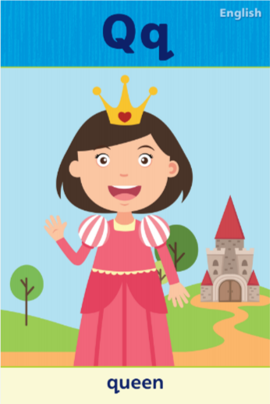
Phonics
Qu
qu
Notes:
Tell students that the sound /kw/ is spelled qu. The letter q is usually followed by the letter u.
Display the Qq Alphabet Card. Point to the picture of the queen and tell students the word queen begins with qu. Point to the letters on the card, and tell students the names of these letters are uppercase Q and lowercase q. lick path -> Table of Contents -> Unit 3 Week 3 Poetry-> Lesson 3
Write Qu and qu on the board and slowly trace the letters as you say the sound /kw/.

Slide 37
Page 104
Phonics
Turn to page 104 in your Student Interactive and complete the activity.
Notes:
Have students turn to p. 104 in the Student Interactive. Let’s look at the first picture, queen, and listen to the beginning sound: /kw/ -een. Do you hear the sound /kw/ at the beginning of queen? Yes, so let’s circle the picture and trace the letters on the lines.
Students should trace the uppercase and lowercase letters.
Name the picture words on p. 104 with students, and have them complete the activity.

Slide 38
Page 105
High-Frequency Words
Turn to page 105 in your Student Interactive and complete
the activity.
Notes:
Tell students that today they are going to work with this week’s high-frequency words. Have students read the words at the top of p. 105 in the Student Interactive with you: her, how, down.
Have students look at the words at the top of p. 105. Tell them to identify and point to each word when you say it. Say how. Pause to let students find and point to the word. Say down. Say her. Repeat the activity until students are familiar with each word.
Have students use the words in sentences.
Have students read the sentences on p. 105 with you. Ask them to identify the words her, how, and down in the sentences. Then have them read the sentences and underline the high-frequency words.

Slide 39
Page 115
Discuss Rhyme and Rhythm
Notes:
Tap out a simple beat on your desk or a table. Ask students to repeat the beat and tap it out. Explain that the tapping has a beat or rhythm, and poems and nursery rhymes also have a rhythm. Then explain to students that poems and nursery rhymes also have rhymes. Say the words cat and bat. Tell students that the words rhyme because they share the sounds /at/.
Read pp. 118–119 from the Student Interactive to students with a clear rhythm, tapping the beat as you read. Say: We can hear that the words fit the beat I am tapping.
Have students look at the same pages in the Student Interactive. Point out to them that fall rhymes with wall. Say: I can tell these words rhyme because they end with the same sounds. Say both words to students so they can hear the rhyme.

Slide 40
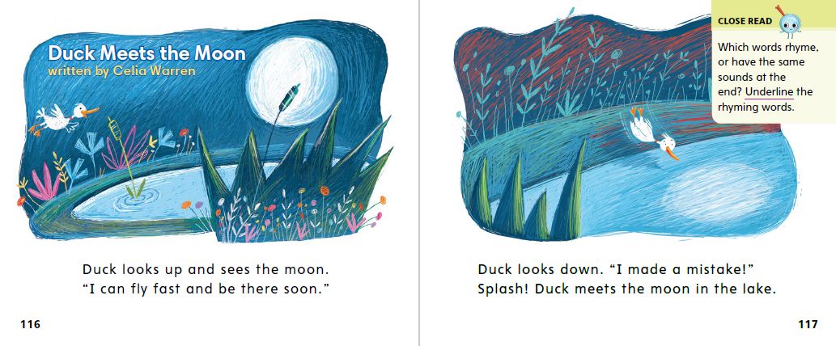
Page 116, 117
Close Read – Discuss Rhyme and Rhythm
Turn to page 1116-117 in your Student
Interactive.
Notes:
Discuss the words that rhyme in the poem on pp. 116–117 in the Student Interactive. Then have students underline the rhyming words. DOK 2

Slide 41
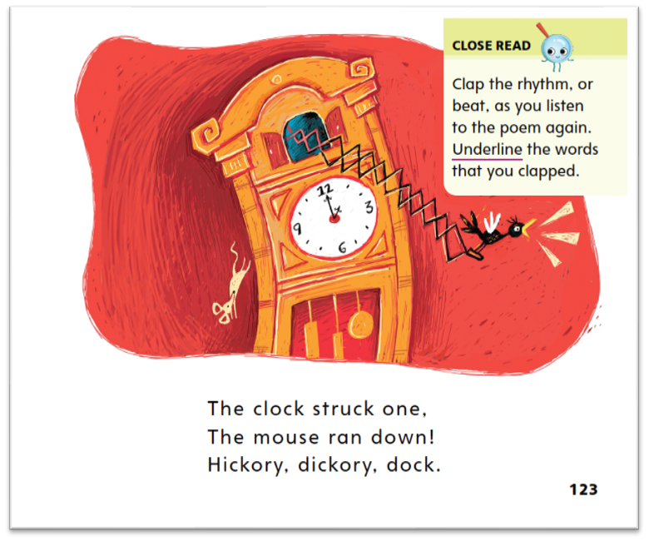
Page 123
Close Read – Discuss Rhyme and Rhythm
Turn to page 115 in your Student
Interactive.
Notes:
Talk about rhythm in the poem, and have students clap the beats. Then talk about the words that rhyme on these two pages. Have students underline the words that rhyme. DOK 2

Slide 42
Page 126
Discuss Rhyme and Rhythm
Turn to page 126 in your Student Interactive and complete the activity.
Notes:
Have students use the strategies for discussing rhythm and rhyme.
Have students turn to p. 126 in the Student Interactive and complete the activities.

Slide 43
Read Like a Writer, Write For a Reader
Jose tiptoed up to the box where three little furry kittens slept. Carefully, he peeked inside.
Notes:
Explain that authors of poems use descriptive language to help readers create a picture in their minds.
When I read a poem, I notice what the words are telling me. I try to picture this in my mind. This helps me understand the poem.
Have students close their eyes while you read the following: Jose tiptoed up to the box where three little furry kittens slept. Carefully, he peeked inside.
Ask students to open their eyes and tell what picture they made in their mind as you said the words.

Slide 44
Page 131
Read Like a Writer, Write For a Reader
Turn to page 131 in the Student Interactive and complete the activity.
Notes:
Have students complete p. 131 of the Student Interactive.

Slide 45
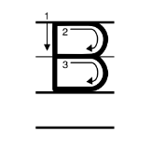
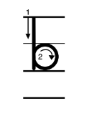
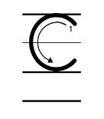
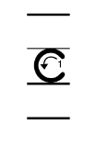
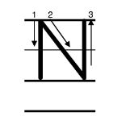
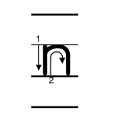
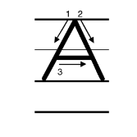
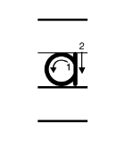
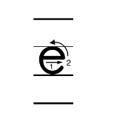
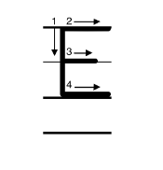
Handwriting
Notes:
Display the letters Bb, Cc, Nn, Aa, and Ee. Have students read aloud the letters as you point to each one.
Model correct spacing between letters in a word. Watch as I write the word Ben. After I write uppercase B, I need to write lowercase e. I need to make sure that there is neither too much nor too little space between the letters. Finish writing the name Ben.
Have students write the words can and cab with appropriate spacing between the letters in each word. Guide students to use appropriate directionality when forming each letter.
Have students use Handwriting p. 143 in the Resource Download Center to practice writing letters as words.

Slide 46
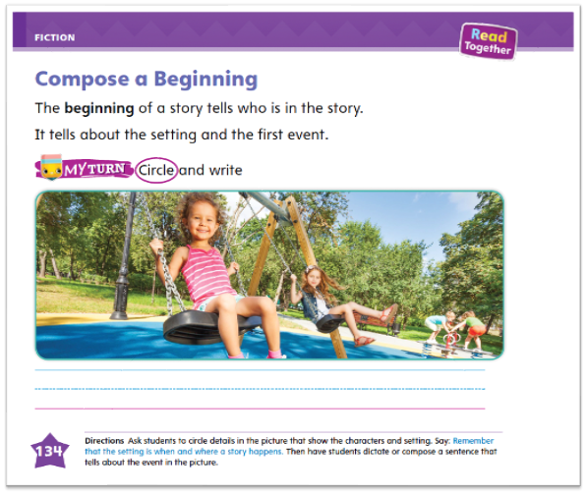
Page 134
Writing – Fiction
Turn to page 134 in the Student
Interactive
and complete
the activity.
Notes:
Characters, setting, and events can be based on real life or they can be created from someone’s imagination. When authors write the beginning of their story, they introduce the characters, the setting, and the first event.
Refer to a stack book to discuss how characters, setting, and action are introduced at the beginning of a story. Say: Now we are going to create our own beginning of a story. We need main characters, a setting, and a first event.
Ask questions to brainstorm the beginning of a story. For example: Is the main character a human or an animal? Where are our characters? What is something that they see or do together? Write the answers and suggestions on the board. If students provide answers quickly, direct them to provide more detail for the characters, setting, and first event.
Compose a few sentences to serve as a model for the beginning of a fiction book.
Direct students to p. 134 in the Student Interactive. Read the page aloud and guide students to complete the activity.

Slide 47
Independent Writing
Let’s continue working on our fiction books. Be sure to write a good beginning.
If you have composed your beginning already, reread it and try to improve it. Then, continue writing your fiction book.
Notes:
Have students continue working on their fiction books. Tell them to write a good beginning.
MODEL Walk through a stack text with students to help them identify the character, setting, and event information they could model as they write.
SHARED Have students dictate their story beginning as you transcribe.
GUIDED Ask students questions as they work together, prompting them to use their imaginations in creating the characters, setting, and first event.
If students have composed their beginning already, have them use this time to reread their beginning and improve it. Then they should continue writing their fiction books.
Call on a few students with whom you conferred to share the beginning of their stories. Prompt the class to discuss what could happen next in the story and tell students to respond to the suggestions.

Slide 48
Language and Conventions-Pronouns
That book belongs to Jaden and Carmin.
It is ______ book.
It is ______.
my/mine
your/yours
her/hers
his/his
their/theirs
Notes:
Tell students that possessive pronouns show that something belongs to someone.
Provide the following for student reference: my/mine; your/yours; her/hers; his/his; their/theirs. Provide sentences: That book belongs to Jaden and Carmin. It is _____ book. It is _____. In the second and third sentences, I need to use the pronouns their and theirs because there are two names. I will say: “It is their book. It is theirs.” I use theirs when a pronoun is not in front of a noun. I use their in front of the object.
Call on different students to complete the following sentences orally using the correct pronouns: That book belongs to Sasha. It is ____ book. It is _____. That book belongs to you. It is ____ book. It is ____.

Slide 49
Lesson 4

Slide 50
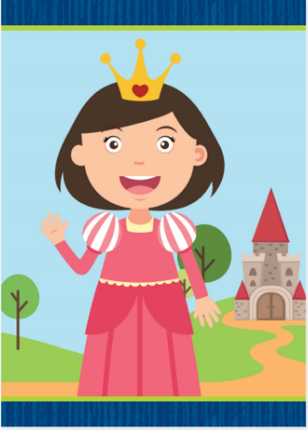
Page 106
Phonics
Turn to page 106 in the Student
Interactive
and complete
the activity.
Notes:
Hold up the queen Picture Card. This is a picture of a queen. I hear the sound /kw/ at the beginning of queen. Say the sound /kw/ with me. lick path -> Table of Contents -> Unit 3 Week 3 Poetry-> Lesson 4
Turn over the card and show students the spelling of queen. Point to the letters qu and say /kw/. Do you hear the /kw/ sound? What letters spell the sound /kw/? Have students identify the letters qu.
Write the letters Qu and qu on the board. Have students trace the letters Qu and qu in the air as you lead them.
Point to the letters Qu and qu on the board. Listen carefully to the following words: /kw/ -een, /k/ -itten. Which word begins with the sound /kw/? Have a volunteer identify the word queen. What letters spell the sound /kw/? Students should say qu. Display the following words, and have students decode them: quit, quiz, Quin.
Have students complete p. 106 in the Student Interactive.

Slide 51
Page 107
Decodable Story
Turn to page 107 in your Student Interactive. We will Read “Quin at Bat”.
down
her
how
Notes:
Have students turn to p. 107 in the Student Interactive.
We are going to read a story today about a girl who plays a game. Point to the title of the story. The title of the story is Quin at Bat. I hear the sound /kw/ in the word Quin. What other sounds do you hear in the word /kw/ /i/ /n/? Students should come up with /i/ and /n/. In this story, we will read other words that have sounds you have learned.
Remind students of this week’s high-frequency words: down, her, how. Tell them they will practice reading these words in the story Quin at Bat.
Display the words. Have students read them with you. When you see these words in the story Quin at Bat, you will know how to identify and read them.
Have students whisper read the story as you listen in.
Next, have students reread the story page by page with a partner. Listen carefully as they use letter-sound relationships to decode. Partners should reread the story. This time, the other student begins.
After students have read the story, call their attention to the first sentence on p. 107. I see the letters Qu in this word: Quin. What sound do the letters Qu spell? Help them identify, or say, the sound /kw/.

Slide 52
Page 108, 109
Decodable Story
Notes:
Have students turn to pp. 108–109. Which words have the sound /z/ spelled z? Highlight the words. Which words have the sound /kw/ splled qu? Underline them. Point to them.
Point out the multiple-meaning word bat in the story’s title, “Quin at Bat.” Have students point out the two other times the word bat appears in the story. Have them look at the pictures and read the text to determine or clarify the meaning of the word. Ask students if they know another meaning of the word bat.

Slide 53
Page 115
Ask and Answer Questions
Turn to page 115 in your Student
Interactive.
Notes:
Tell students that good readers ask themselves questions about what they are reading.
If something you read doesn’t make sense, ask yourself a question about what you do not understand.
If you wonder about something you are reading, ask yourself a question.
Read on or reread to see if you can find the answer.
Have students look at pp. 116–117 in the Student Interactive. Say, These pages make me think of some questions. Why did Duck fall into the lake? Have students discuss and attempt to answer the question. Then have them look at the Close Read note on p. 119 and highlight words that help them think of questions.

Slide 54
Page 116, 117
Close Read – Ask and Answer Questions
Turn to page 116 and 117 in your Student
Interactive.
Notes:
Have students look at pp. 116–117 in the Student Interactive. Say, These pages make me think of some questions. Why did Duck fall into the lake? Have students discuss and attempt to answer the question.

Slide 55
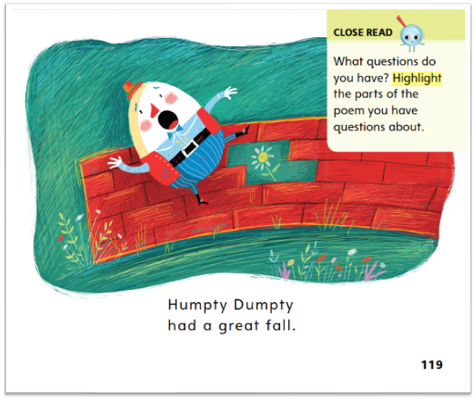
Page 119
Close Read – Ask and Answer Questions
Turn to page 119 in your Student
Interactive.
Notes:
Read the Close Read note on p. 119 with students. Tell students to highlight parts of the text they have questions about. DOK 3

Slide 56
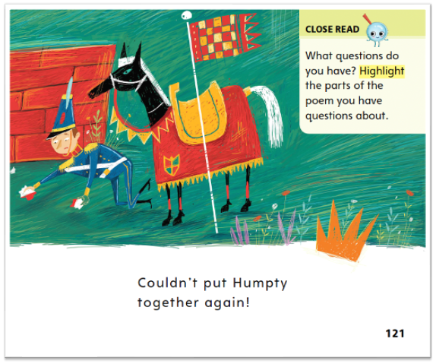
Page 121
Close Read – Ask and Answer Questions
Turn to page 121 in your Student
Interactive.
Notes:
Read the Close Read note on p. 121 with students. Have students take turns asking questions about these pages.
Then have them highlight parts of the poem they have questions about. DOK 3

Slide 57
Page 127
Ask and Answer Questions
Turn to page 127 in your Student Interactive and complete the activity.
Notes:
Have students use the strategies for asking and answering questions.
Have students complete the My Turn activity on p. 127 by drawing a picture to show the answer to their question.

Slide 58
Writing – Fiction
When you write your own books, you should write an ending that solves the problem.
Notes:
A story often concludes with an event that resolves the problem in the story. The ending tells what happens to the characters in the story and how they resolved a conflict or challenge.
Hold up a book from your stack and turn to the last page. The author of this book wrote an ending. The ending shows us what happened to the characters. At the end of the book, the author tells us how the problem is solved.
Read the book aloud and tell students to listen for the last event that happens. After reading, return to the ending of the book and point out the final event. Ask students if the problem is solved.
Hold up a second stack book that your class is already familiar with. Say: At the beginning of this book, the author introduced the characters, the setting, and the problem. At the end of the book, the author will tell us how the problem is solved. Does anyone remember the problem in this book? What is it? Have students recall the problem. Now let’s read the end of the book to see how the problem is solved.
When you write your own books, you should write an ending that solves the problem.

Slide 59
Independent Writing
Now it is time to work on your story endings.
If you have composed your ending already, reread your beginning and ending and continue writing your fiction book.
Notes:
Have students continue working on their fiction books. Tell students to work on their endings.
MODELED - Think aloud about an ending to a story.
SHARED - Encourage students to talk about their ending ideas as you transcribe their notes.
GUIDED - Prompt students to identify what would be a good ending to the story.
If students have composed their endings already, have them use this time to reread their beginning and ending and continue writing their fiction books.
Call on a few students with whom you conferred to share the problem in their story and explain what they will write in the ending to solve it.

Slide 60
Page 132
Language and Conventions
Turn to page 132 in your Student Interactive and complete the activity.
Notes:
Have students edit for possessive case pronouns to complete the activity on p. 132 in the Student Interactive
Depending on your students, have them work with a partner, independently, or with teacher guidance.

Slide 61
Lesson 5

Slide 62
Phonological Awareness
The quilt is blue and red.
How many words are
in each
sentence?
My cat zigs and zags.
Matt can zip his coat.
Notes:
Listen carefully as I say a sentence: The quilt is blue and red. Repeat the sentence with me. Have students repeat the sentence and clap as they say each word. Repeat the sentence and have students count the words. How many words are in the sentence? Yes, there are six words in the sentence.
Say sentences, such as: My cat zigs and zags. Matt can zip his coat. I will not quit the team. Have students say each sentence aloud and clap once for each word. Then have them tell you how many words are in the sentence.

Slide 63
Page 110, 111
Phonics
Turn to page 110 and 111 in your Student Interactive.
Qu
qu
Zz
Notes:
Write the letters Zz and Qu qu on the board. Have students identify the letters as you point to them. Then have students identify the sound that the letters spell: z /z/, qu /kw/.
Tape a Zz or a Qu card on each student.
Then write the word zip on the board. We will read this word together. If you hear the sound /kw/ spelled qu, stand up if you have a Qu taped to you. If you hear the sound /z/ spelled z, stand up if you have a Zz taped to you. Point to each letter as you say the sound. Let’s read this word together: /z/ /i/ /p/, zip.
Repeat with the words quit, zap, Zak, quilt, and Quin.
Have students turn to p. 110 in the Student Interactive and read the words with a partner. Then have students write one of the words on the lines.
Have students look at p. 111 in the Student Interactive. Have them circle the words with qu and underline the words with z. Then have partners take turns reading the text.

Slide 64
High-Frequency Words
her
down
how
Notes:
(Note: Move the orange boxes to cover each bold spelling word before you read aloud the words and sentences.)
Remind students that high-frequency words are words that appear over and over in texts. Remind them they will be learning many of these words this year, and the words will help them become better readers.
Say the word her and ask students what letters spell the word. Have students
say the letters as you write them on the board.
say and spell the word, clapping their hands for each letter.
repeat with down and how.

Slide 65
Reflect and Share
Poem
Story
Notes:
Explain that stories and poems are alike in many ways but they are also different. Create a Venn diagram with the headings Poem and Story. Ask students for their ideas as you complete the Venn diagram.
How are poems and stories alike?
How are poems and stories different?
I look at the poem “Duck Meets the Moon” and I notice that it tells a little story about what Duck does. This is similar to a story.
Model writing “both can tell a story” in the middle of the Venn diagram. Then have students suggest other ideas for the Venn diagram.

Slide 66
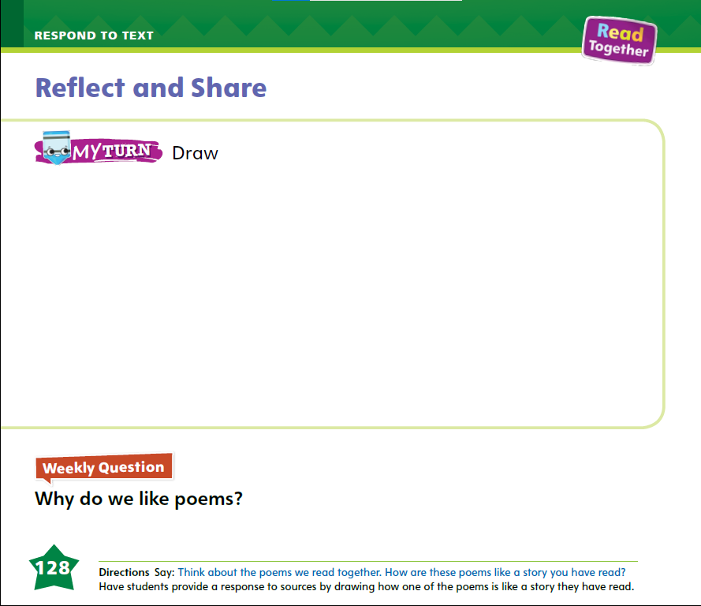
Page 128
Reflect and Share
Turn to page 46 in your Student Interactive.
Notes:
Have students use the strategies for comparing texts.
Have students draw a picture on p. 128 in the Student Interactive that shows something that both a story and a poem have. Provide support if students have difficulty.

Slide 67
Page 128
Reflect and Share
Why do we like poems?
Notes:
Have students use evidence from the texts they have read this week to respond to the Weekly Question. Tell them to discuss in small groups or write or draw their responses on a separate sheet of paper.

Slide 68
Page 135
Writing – Fiction
Turn to page 135 in your Student Interactive.
Notes:
A story generally ends with a problem being resolved. The character went through changes and learned to solve a problem or overcome a challenge. An author also tells the character’s reaction to the solved problem, such as “I was so happy it was finally over!” Then the author writes an ending for his or her book to wrap up the story.
Hold up a stack text that you have read before. Have students recall what happens at the end of the story. As students remember, record their responses. Explain that sometimes authors think of more than one ending to their story because they may not be sure what the best ending would be.
Read or retell a stack text. Identify the main characters and setting. Have students discuss how a character might have reacted after the problem was solved. Think aloud about the problem in the plot. Recall how the story ends. Say: Let’s pretend we wrote this book, but we don’t like the ending. We want to think of a new ending. Let’s brainstorm other ways the problem could have been solved. What other ways could the problem have been solved? Have students suggest other endings for the story as you write them on the board or flip chart.
When you have finished brainstorming, ask students to vote on their favorite new ending. With students’ help, compose a sentence to serve as a new ending for the book.
Have students turn to p. 135 in the Student Interactive. Read the page with students. Then have them dictate or compose an ending for the story.
Have a few students read their stories aloud to the class. When they are finished reading, prompt the students to identify what happened to the characters at the end of the story.

Slide 69
Language and Conventions
Which possessive pronoun is correct?
This is _____ bike.
her
hers
him
theirs
Notes:
Display the following and guide students to select the correct possessive pronoun.
This is _____ bike.
A. her
B. hers
C. him
D. Their
2. Have students complete Language and Conventions p. 150 from the Resource Download Center.
Click path: Table of Contents -> Resource Download Center -> Language and Conventions -> U3 W3

Slide 70
Unit 3: Week 3
Grade K

